Slide 1
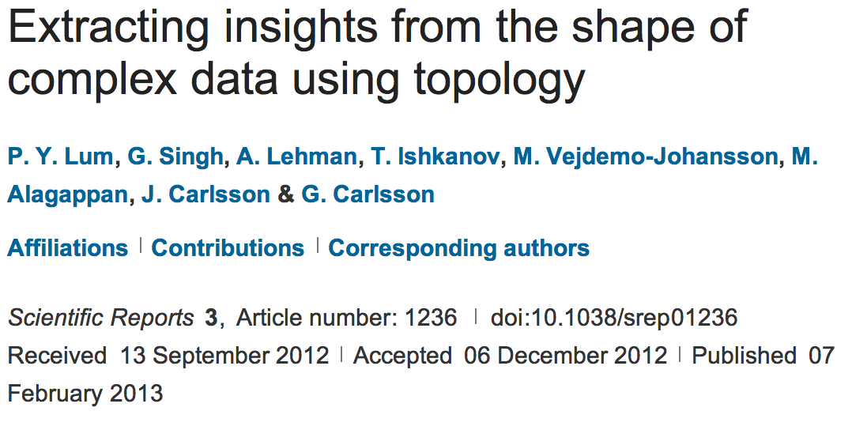
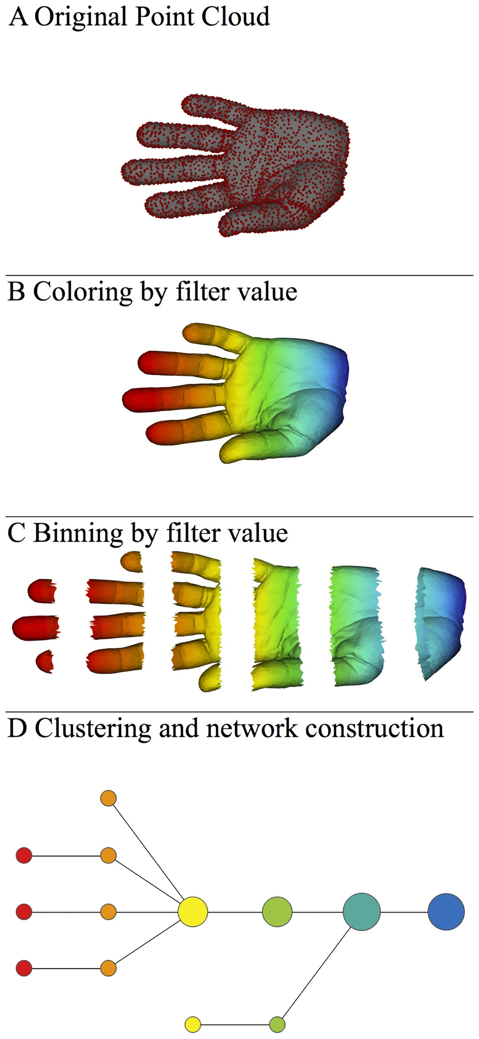
http://www.nature.com/srep/2013/130207/srep01236/full/srep01236.html

Slide 2

A) Data Set
Example: Point cloud data
representing a hand.
http://www.nature.com/srep/2013/130207/srep01236/full/srep01236.html

Slide 3
Function f : Data Set → R
Ex 1: x-coordinate
f : (x, y, z) → x
http://www.nature.com/srep/2013/130207/srep01236/full/srep01236.html

Slide 4
Function f : Data Set → R
Ex 1: x-coordinate
f : (x, y, z) → x
http://www.nature.com/srep/2013/130207/srep01236/full/srep01236.html

Slide 5
Function f : Data Set → R
Ex 1: x-coordinate
f : (x, y, z) → x
http://www.nature.com/srep/2013/130207/srep01236/full/srep01236.html

Slide 6
Put data into overlapping bins.
Example: f⁻¹(a_{i}, b_{i})
( ( ) ( ) ( ) ( ) ( ) )
Function f : Data Set → R
Ex 1: x-coordinate
f : (x, y, z) → x
http://www.nature.com/srep/2013/130207/srep01236/full/srep01236.html

Slide 7
Put data into overlapping bins.
Example: f⁻¹(a_{i}, b_{i})
( ( ) ( ) ( ) ( ) ( ) )
Function f : Data Set → R
Ex 1: x-coordinate
f : (x, y, z) → x
http://www.nature.com/srep/2013/130207/srep01236/full/srep01236.html

Slide 8
Data Set
Example: Point cloud data
representing a hand.
Function f : Data Set → R
Example: x-coordinate
f : (x, y, z) → x
Put data into overlapping bins.
Example: f⁻¹(a_{i}, b_{i})
http://www.nature.com/srep/2013/130207/srep01236/full/srep01236.html

Slide 9
D) Cluster each bin
http://www.nature.com/srep/2013/130207/srep01236/full/srep01236.html
Notes:
Need covering Resolution multiscale

Slide 10
D) Cluster each bin
http://www.nature.com/srep/2013/130207/srep01236/full/srep01236.html
Notes:
Need covering Resolution multiscale

Slide 11
D) Cluster each bin
& create network.
Vertex = a cluster of a bin.
Edge = nonempty intersection
between clusters
http://www.nature.com/srep/2013/130207/srep01236/full/srep01236.html
Notes:
Need covering Resolution multiscale

Slide 12
D) Cluster each bin
& create network.
Vertex = a cluster of a bin.
Edge = nonempty intersection
between clusters
http://www.nature.com/srep/2013/130207/srep01236/full/srep01236.html
Notes:
Need covering Resolution multiscale

Slide 13
A) Data Set
Example: Point cloud data
representing a hand.
B) Function f : Data Set → R
Example: x-coordinate
f : (x, y, z) → x
Put data into overlapping bins.
Example: f⁻¹(a_{i}, b_{i})
Cluster each bin & create network.
Vertex = a cluster of a bin.
Edge = nonempty intersection
between clusters
http://www.nature.com/srep/2013/130207/srep01236/full/srep01236.html

Slide 14
Note: we made many, many choices
It helps to know what you are doing when you make choices, so collaborating with others is highly recommended.

Slide 15
We chose how to model the data set
A) Data Set
Example: Point cloud data
representing a hand.
http://www.nature.com/srep/2013/130207/srep01236/full/srep01236.html
Notes:
Be creative. Use ideas from pure and applied math (including stat) as well as area of application
Missing data, noise

Slide 16
Function f : Data Set → R
Ex 1: x-coordinate
f : (x, y, z) → x
Chose filter function
http://www.nature.com/srep/2013/130207/srep01236/full/srep01236.html

Slide 17
Function f : Data Set → R
Ex 1: x-coordinate
f : (x, y, z) → x
Ex 2: y-coordinate
g : (x, y, z) → y
Chose filter function
http://www.nature.com/srep/2013/130207/srep01236/full/srep01236.html

Slide 18
Function f : Data Set → R
Ex 1: x-coordinate
f : (x, y, z) → x
Chose filter function
Possible filter functions:
Principle component analysis
L-infinity centrality:
f(x) = max{d(x, p) : p in data set}
Norm: f(x) = ||x || = length of x
http://www.nature.com/srep/2013/130207/srep01236/full/srep01236.html
Notes:
Need distance
Depends on what prop you want to explore
Can also choose any co-domain

Slide 19
Chose bins
Put data into overlapping bins.
Example: f⁻¹(a_{i}, b_{i})
If equal length intervals:
Choose length.
Choose % overlap.
http://www.nature.com/srep/2013/130207/srep01236/full/srep01236.html
Notes:
Need covering Resolution multiscale

Slide 20
Chose how to cluster.
Normally need a definition of distance between data points
Cluster each bin & create network.
Vertex = a cluster of a bin.
Edge = nonempty intersection
between clusters
http://www.nature.com/srep/2013/130207/srep01236/full/srep01236.html

Slide 21
Note: we made many, many choices
It helps to know what you are doing when you make choices, so collaborating with others is highly recommended.

Slide 22
Note: we made many, many choices
“It is useful to think of it as a camera, with lens adjustments and other settings. A different filter function may generate a network with a different shape, thus allowing one to explore the data from a different mathematical perspective.”
http://www.nature.com/srep/2013/130207/srep01236/full/srep01236.html

Slide 23
Note: we made many, many choices
“It is useful to think of it as a camera, with lens adjustments and other settings. A different filter function may generate a network with a different shape, thus allowing one to explore the data from a different mathematical perspective.”
False positives???
http://www.nature.com/srep/2013/130207/srep01236/full/srep01236.html

Slide 24
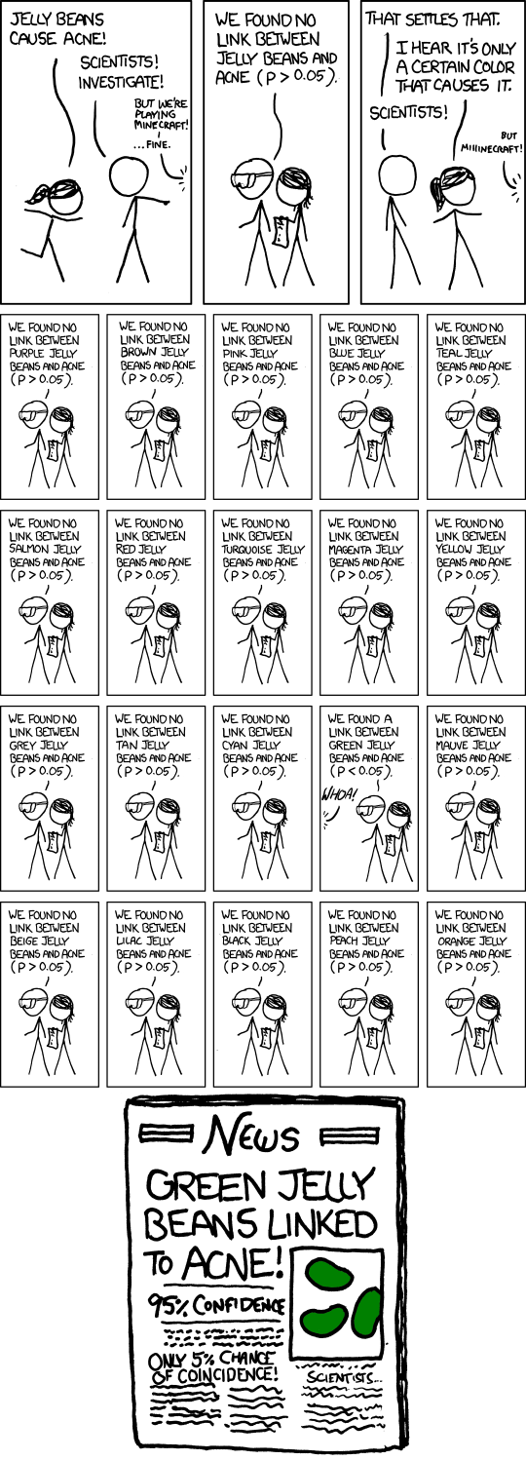
False Positives will occur

Slide 25
Note: we made many, many choices
“It is useful to think of it as a camera, with lens adjustments and other settings. A different filter function may generate a network with a different shape, thus allowing one to explore the data from a different mathematical perspective.”
False positives vs persistencia
http://www.nature.com/srep/2013/130207/srep01236/full/srep01236.html

Slide 26
Function f : Data Set → R
Ex 1: x-coordinate
f : (x, y, z) → x
Chose filter function
http://www.nature.com/srep/2013/130207/srep01236/full/srep01236.html

Slide 27
Function f : Data Set → R
Ex 1: x-coordinate
f : (x, y, z) → x
Chose filter function
( ( ) ( ) ( ) ( ) ( ) )
http://www.nature.com/srep/2013/130207/srep01236/full/srep01236.html

Slide 28
Chose filter
Only need to cover the data points.
http://www.nature.com/srep/2013/130207/srep01236/full/srep01236.html

Slide 29
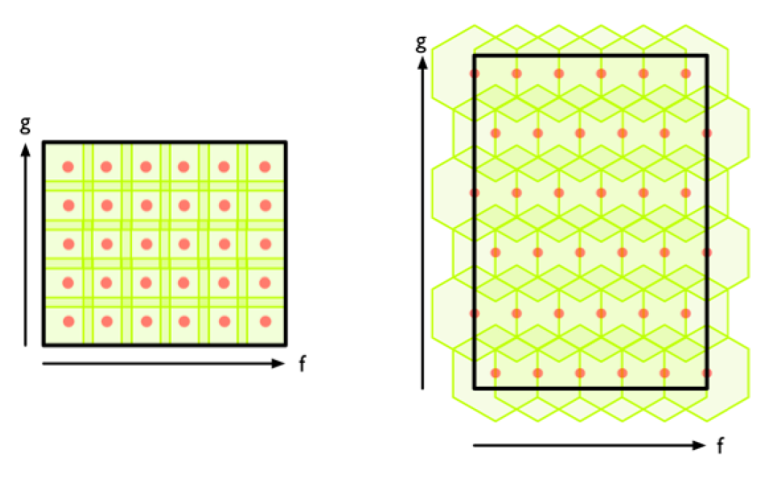
Chose filter
http://www.nature.com/srep/2013/130207/srep01236/full/srep01236.html

Slide 30
Chose filter
http://www.nature.com/srep/2013/130207/srep01236/full/srep01236.html

Slide 31
Application 3 (in paper): Basketball
Data: rates (per minute played) of rebounds, assists, turnovers, steals, blocked shots, personal fouls, and points scored for 452 players.
➔ Input: 452 points in R⁷
For each player, we have a vector
= (r, a, t, s, b, f, p) in R⁷
Distance: variance normalized Euclidean distance.
Clustering: Single linkage.
( min , min , min , min , min , min , min )
rebounds assists turnovers steals blocked shots personal fouls points scored
http://www.nature.com/srep/2013/130207/srep01236/full/srep01236.html

Slide 32
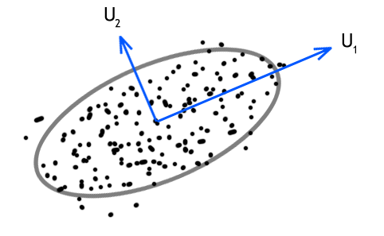
Filters: principle and secondary SVD values.
http://commons.wikimedia.org/wiki/File:SVD_Graphic_Example.png
Data
http://www.nature.com/srep/2013/130207/srep01236/full/srep01236.html

Slide 33
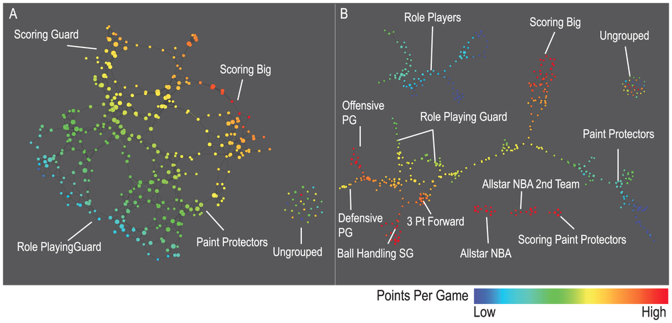
A) Low resolution map at 20 intervals for each filter B) High resolution map at 30 intervals for each filter. The overlap is such at that each interval overlaps with half of the adjacent intervals, the graphs are colored by points per game, and a variance normalized Euclidean distance metric is applied. Metric: Variance Normalized Euclidean; Lens: Principal SVD Value (Resolution 20, Gain 2.0x, Equalized) and Secondary SVD Value (Resolution 20, Gain 2.0x, Equalized). Color: red: high values, blue: low values.
http://www.nature.com/srep/2013/130207/srep01236/full/srep01236.html

Slide 34
LeBron James , Kobe Bryant, Brook Lopez
A) Low resolution map at 20 intervals for each filter B) High resolution map at 30 intervals for each filter. The overlap is such at that each interval overlaps with half of the adjacent intervals, the graphs are colored by points per game, and a variance normalized Euclidean distance metric is applied. Metric: Variance Normalized Euclidean; Lens: Principal SVD Value (Resolution 20, Gain 2.0x, Equalized) and Secondary SVD Value (Resolution 20, Gain 2.0x, Equalized). Color: red: high values, blue: low values.
http://www.nature.com/srep/2013/130207/srep01236/full/srep01236.html
Notes:
Compare how graphs drawn. Note disconnected means not close Don’t be mislead by graph drawing

Slide 35
Topological Data Analysis (TDA): Three key ideas of topology that make extracting of patterns via shape possible.
1.) coordinate free.
No dependence on the coordinate system chosen.
Can compare data derived from different platforms
vital when one is studying data collected with different technologies, or from different labs when the methodologies cannot be standardized.
http://www.nature.com/srep/2013/130207/srep01236/full/srep01236.html

Slide 36
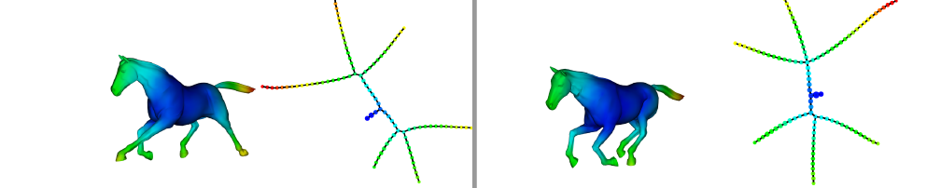
Topological Data Analysis (TDA): Three key ideas of topology that make extracting of patterns via shape possible.
2.) invariant under “small” deformations.
less sensitive to noise
Topological Methods for the Analysis of High Dimensional
Data Sets and 3D Object Recognition, Singh, Mémoli, Carlsson
Figure from http://comptop.stanford.edu/u/preprints/mapperPBG.pdf
http://www.nature.com/srep/2013/130207/srep01236/full/srep01236.html

Slide 37
Topological Data Analysis (TDA): Three key ideas of topology that make extracting of patterns via shape possible.
3.) compressed representations of shapes.
Input: dataset with thousands of points
Output: network with
13 vertices and 12 edges.
http://www.nature.com/srep/2013/130207/srep01236/full/srep01236.html

Slide 38

What graph do you get when you apply mapper to the ideal trefoil knot?

Slide 39
http://www.nature.com/srep/2013/130207/srep01236/full/srep01236.html

Slide 40
Topological Data Analysis (TDA): Three key ideas of topology that make extracting of patterns via shape possible.
1.) coordinate free.
No dependence on the coordinate system chosen.
Can compare data derived from different platforms
2.) invariant under “small” deformations.
less sensitive to noise
3.) compressed representations of shapes.
Input: dataset with thousands of points
Output: network with 13 vertices and 12 edges.
http://www.nature.com/srep/2013/130207/srep01236/full/srep01236.html

Slide 41
Application 1: breast cancer gene expression
Data: microarray gene expression data from 2 data sets, NKI and GSE2034
Distance: correlation distance
Filters: (1) L-infinity centrality:
f(x) = max{d(x, p) : p in data set}
captures the structure of the points far removed from the center or norm.
(2) NKI: survival vs. death
GSE2034: no relapse vs. relapse
Clustering: Single linkage.

Slide 42
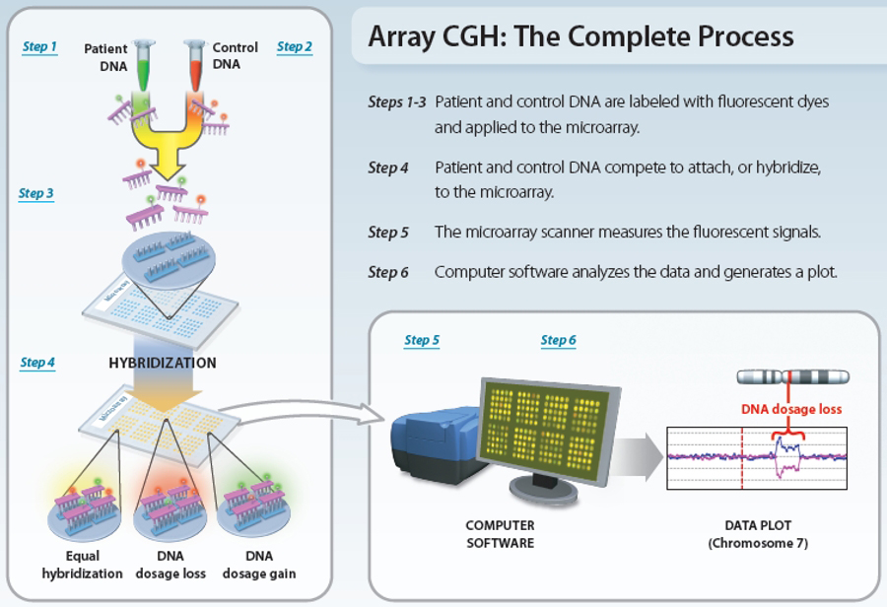
www.nature.com/scitable/topicpage/microarray-based-comparative-genomic-hybridization-acgh-45432

Slide 43
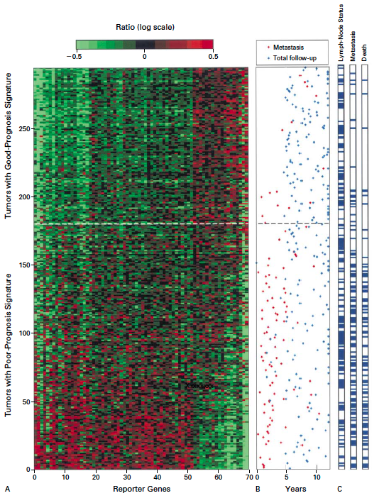
Gene expression profiling predicts clinical outcome of breast cancer
van 't Veer LJ, Dai H, van de Vijver MJ, He YD, Hart AA, Mao M, Peterse HL, van der Kooy K, Marton MJ, Witteveen AT, Schreiber GJ, Kerkhoven RM, Roberts C, Linsley PS, Bernards R, Friend SH
Nature. 2002 Jan 31;415(6871):530-6.

Slide 44
2 breast cancer data sets:
1.) NKI (2002):
gene expression levels of 24,000 from 272 tumors. Includes node-negative and node-positive patients, who had or had not received adjuvant systemic therapy. Also includes survival information.
2.) GSE203414 (2005)
expression of 22,000 transcripts from total RNA of frozen tumour samples from 286 lymph-node-negative patients who had not received adjuvant systemic treatment. Also includes time to relapse information.

Slide 45
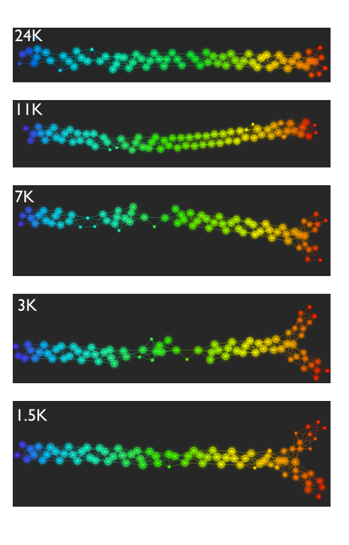
Fig. S1. Shape of the data becomes more distinct as the analysis columns are restricted to the top
varying genes.
24K: all the genes on the microarray were used in the analysis;
11K: 10,731 top most varying genes were used in the analysis;
7K: 6.688 top most varying genes were used in the analysis;
3K: 3212 top most varying genes were used in the analysis;
1.5K: 1553 top most varying genes were used in the analysis.
Graphs colored by the L-infinity centrality values. Red: high; Blue: low
http://www.nature.com/srep/2013/130207/srep01236/full/srep01236.html

Slide 46
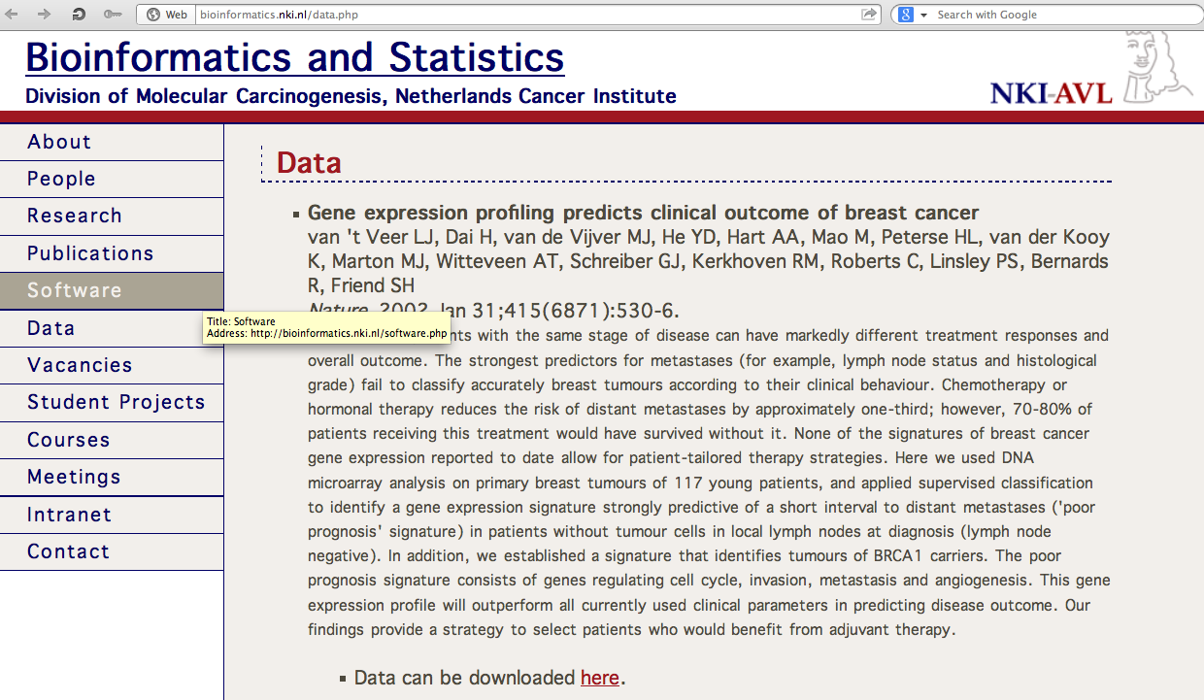
http://bioinformatics.nki.nl/data.php

Slide 47
Comparison of our results with those of Van de Vijver and colleagues is difficult because of differences in patients, techniques, and materials used.
Their study included node-negative and node-positive patients, who had or had not received adjuvant systemic therapy, and only women younger than 53 years.
microarray platforms used in the studies differ—Affymetrix and Agilent.
Of the 70 genes in the study by van't Veer and co-workers, 48 are present on the Affymetrix U133a array, whereas only 38 of our 76 genes are present on the Agilent array. There is a three-gene overlap between the two signatures (cyclin E2, origin recognition complex, and TNF superfamily protein).
Despite the apparent difference, both signatures included genes that identified several common pathways that might be involved in tumour recurrence. This finding supports the idea that although there might be redundancy in gene members, effective signatures could be required to include representation of specific pathways.
From: Gene-expression profiles to predict distant metastasis of lymph-node-negative primary breast cancer, Yixin Wang et al, The Lancet, Volume 365, Issue 9460, 19–25 February 2005, Pages 671–679

Slide 48
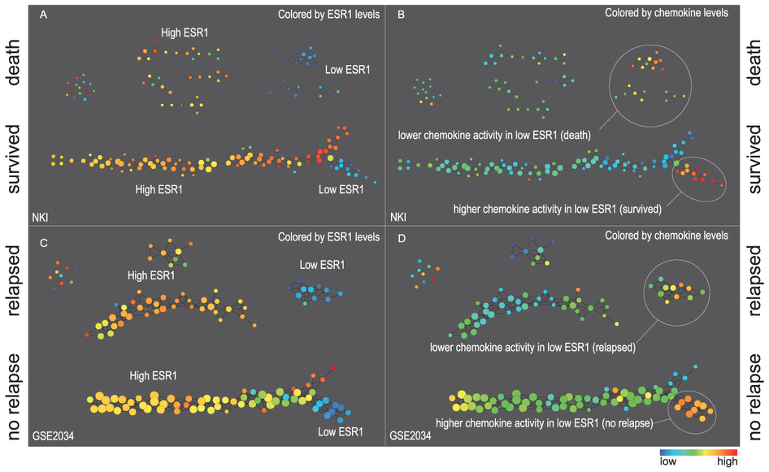
Two filter functions, L-Infinity centrality and survival or relapse were used to generate the networks. The top half of panels A and B are the networks of patients who didn't survive, the bottom half are the patients who survived. Panels C and D are similar to panels A and B except that one of the filters is relapse instead of survival. Panels A and C are colored by the average expression of the ESR1 gene. Panels B and D are colored by the average expression of the genes in the KEGG chemokine pathway. Metric: Correlation; Lens: L-Infinity Centrality (Resolution 70, Gain 3.0x, Equalized) and Event Death (Resolution 30, Gain 3.0x). Color bar: red: high values, blue: low values.
http://www.nature.com/srep/2013/130207/srep01236/full/srep01236.html

Slide 49
Identifying subtypes of cancer in a consistent manner is a challenge in the field since sub-populations can be small and their relationships complex
High expression level of the estrogen receptor gene (ESR1) is positively correlated with improved prognosis, given that this set of patients is likely to respond to standard therapies.
But , there are still sub-groups of high ESR1 that do not respond well to therapy.
Low ESR1 levels are strongly correlated with poor prognosis
But there are patients with low ESR1 levels but high survival rates
Many molecular sub-groups have been identified,
But often difficult to identify the same sub-group in a broader setting, where data sets are generated on different platforms, on different sets of patients and at a different times, because of the noise and complexity in the data.
http://www.nature.com/srep/2013/130207/srep01236/full/srep01236.html

Slide 50
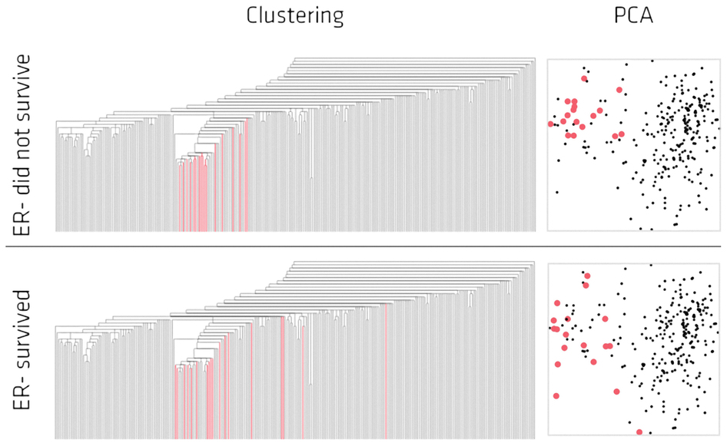
Highlighted in red are the lowERNS (top panel) and the lowERHS (bottom panel) patient sub-groups.
http://www.nature.com/srep/2013/130207/srep01236/full/srep01236.html

Slide 51
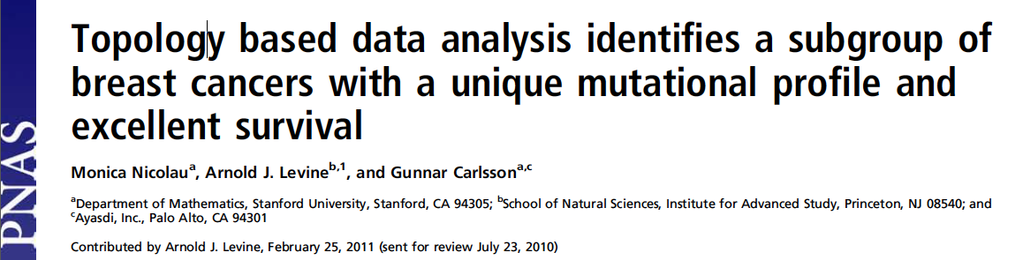
http://www.pnas.org/content/early/2011/04/07/1102826108

Slide 52
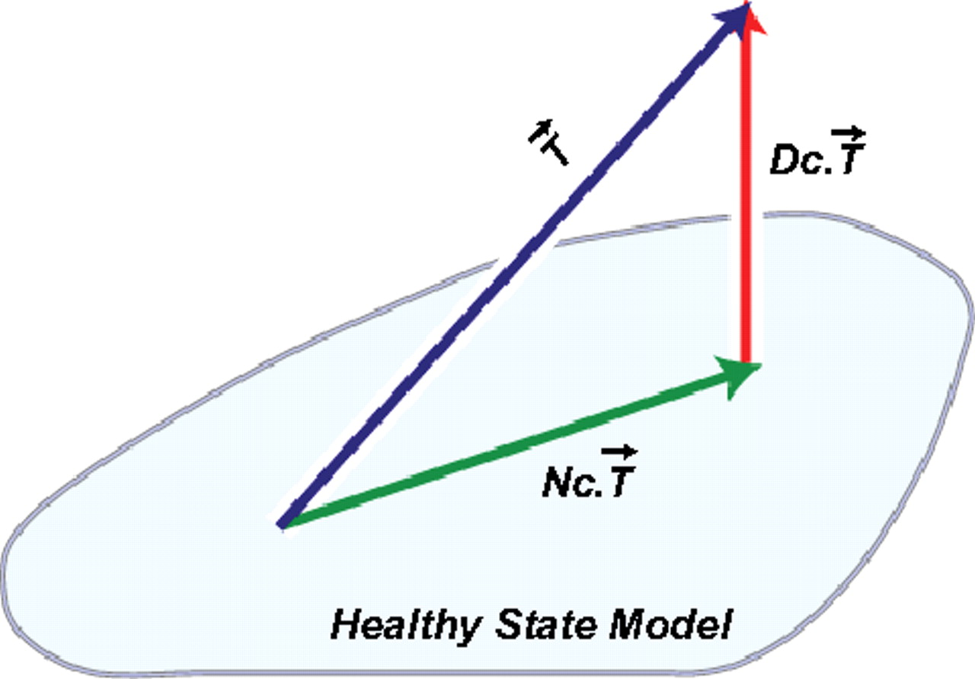

DSGA decomposition of the original tumor vector into the Normal component its linear models fit onto the Healthy State Model and the Disease component vector of residuals.
Nicolau M et al. PNAS 2011;108:7265-7270
©2011 by National Academy of Sciences
Notes:
DSGA decomposition of the original tumor vector into the Normal component its linear models fit onto the Healthy State Model and the Disease component vector of residuals.

Slide 53
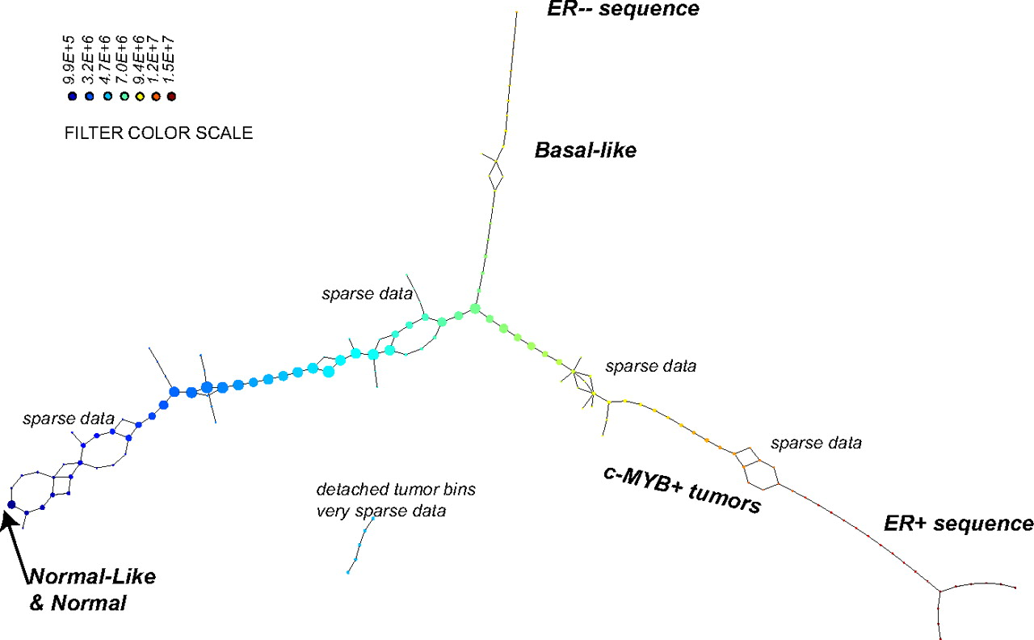
PAD analysis of the NKI data. The output has three progression arms, because tumors (data points) are ordered by the magnitude of deviation from normal (the HSM). Each bin is colored by the mean of the filter map on the points. Blue bins contain tumors whose total deviation from HSM is small (normal and Normal-like tumors). Red bins contain tumors whose deviation from HSM is large. The image of f was subdivided into 15 intervals with 80% overlap. All bins are seen (outliers included). Regions of sparse data show branching. Several bins are disconnected from the main graph. The ER− arm consists mostly of Basal tumors. The c-MYB+ group was chosen within the ER arm as the tightest subset, between the two sparse regions.
PAD analysis of the NKI data.
Nicolau M et al. PNAS 2011;108:7265-7270
©2011 by National Academy of Sciences
Notes:
PAD analysis of the NKI data. The output has three progression arms, because tumors (data points) are ordered by the magnitude of deviation from normal (the HSM). Each bin is colored by the mean of the filter map on the points. Blue bins contain tumors whose total deviation from HSM is small (normal and Normal-like tumors). Red bins contain tumors whose deviation from HSM is large. The image of f was subdivided into 15 intervals with 80% overlap. All bins are seen (outliers included). Regions of sparse data show branching. Several bins are disconnected from the main graph. The ER− arm consists mostly of Basal tumors. The c-MYB+ group was chosen within the ER arm as the tightest subset, between the two sparse regions.

Slide 54
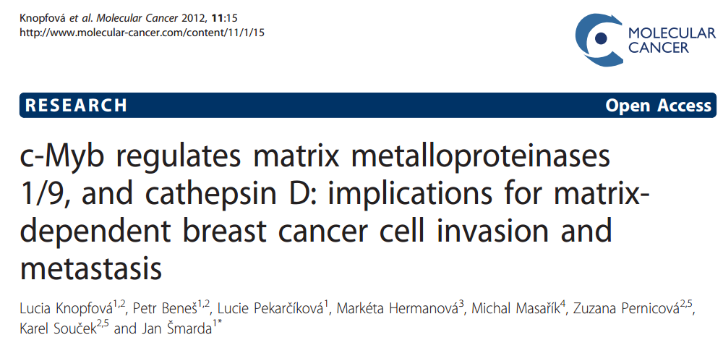
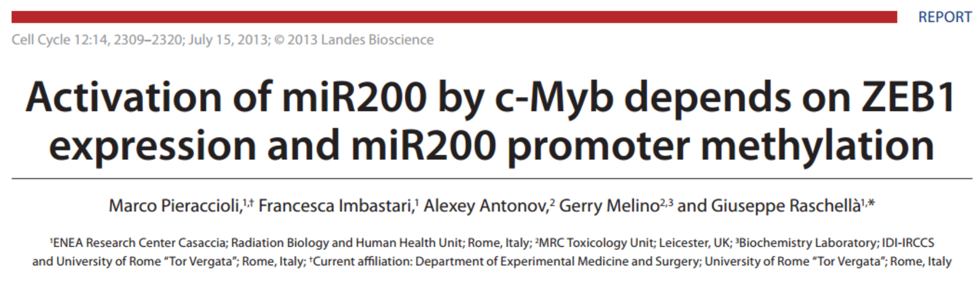

Slide 55
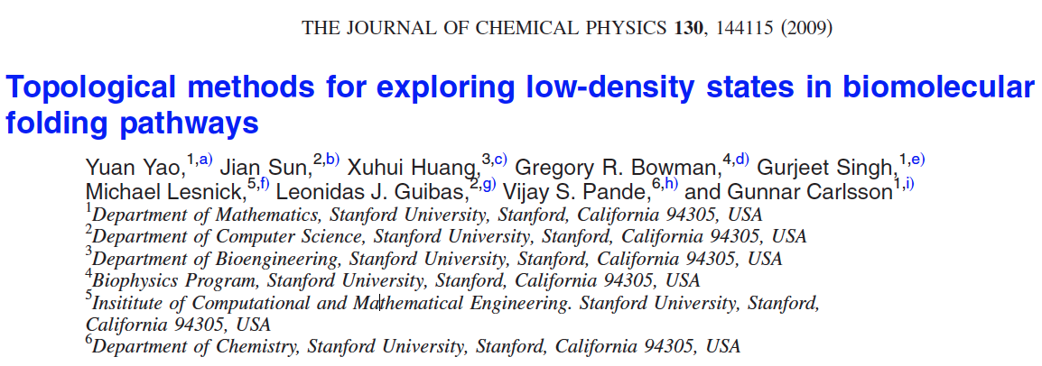
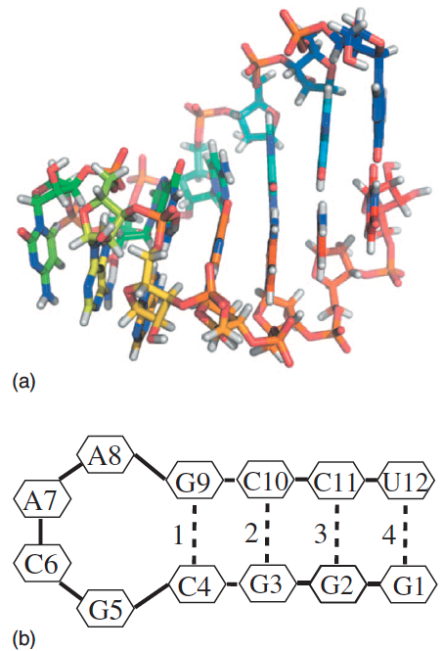
http://scitation.aip.org/content/aip/journal/jcp/130/14/10.1063/1.3103496

Slide 56
Data: Contact maps from 2,800 Serial Replica Exchange Molecular Dynamics (SREMD) simulations of the GCAA tetraloop on the Folding@home distributed computing platform.
760 trajectories with a complete unfolding event
550 trajectories with a complete refolding event.
Goal: To determine secondary structure pathways between folded and unfolded state

Slide 57
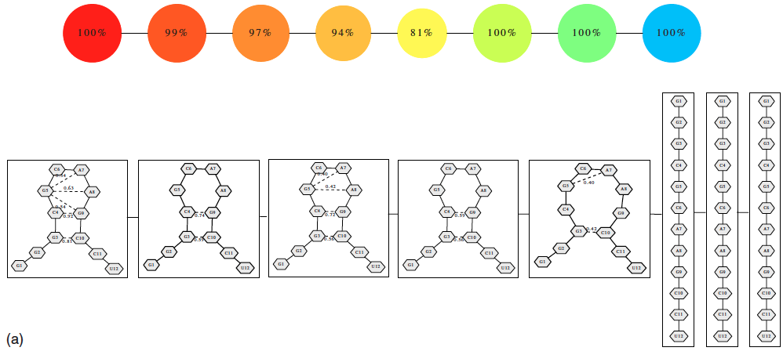
Problem: Many more folded and unfolded conformations than intermediate conformations
How to distinguish intermediate conformations from noise?
Solution
Choose f: space of conformations → R
f(conformation) = density

Slide 58
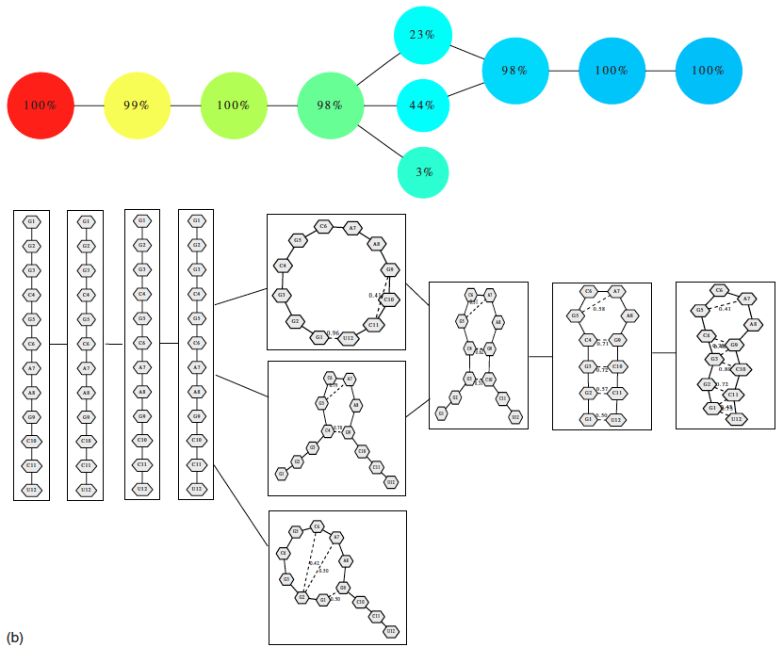
550 trajectories with a complete refolding event
2952 configurations

Slide 59

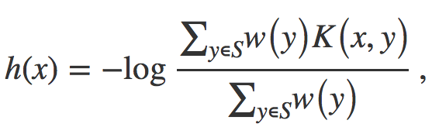
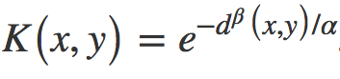

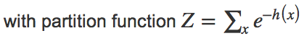
Distance = Hamming distance

Slide 60
550 trajectories with a complete refolding event
2952 configurations

Slide 61
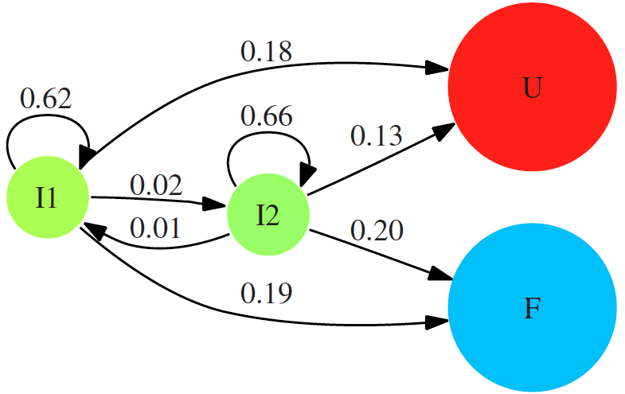

Slide 62
760 trajectories with a complete refolding event
4330 configurations

Slide 63
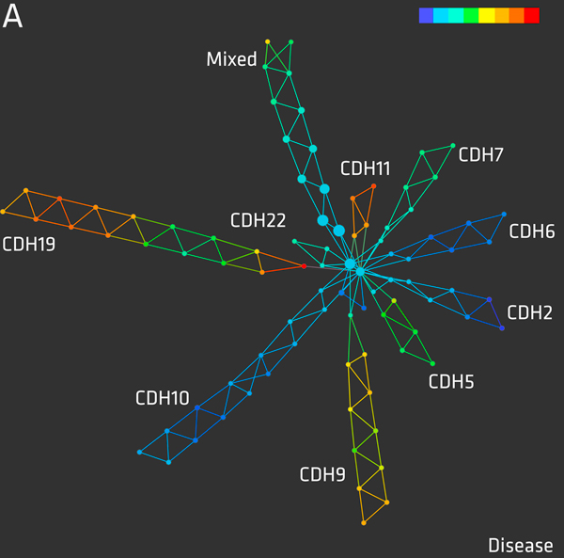
An eQTL biological data visualization challenge and approaches from the visualization community,
Bartlett et al.
BMC Bioinformatics
2012, 13(Suppl 8):S8
Mapper applied
to SNP data:
http://www.biomedcentral.com/1471-2105/13/S8/S8

Slide 64

http://www.ayasdi.com/

Slide 65
From: http://www.ayasdi.com/company/media/seriesc/
Customers Discover Breakthrough Insights That Deliver Significant ROI
Ayasdi currently does business with three of the five largest financial institutions in the world. The company’s financial services customers use Ayasdi to enhance their consumer credit decisions, accelerate the development and accuracy of risk and regulatory models, optimize services for private banking clients, and improve fraud detection models. In each case, financial institutions are finding critical insights and patterns that return hundreds of millions of dollars in ROI.

Slide 66
From: http://www.ayasdi.com/company/media/seriesc/
Ayasdi expanded its healthcare portfolio with client wins in both the provider and payer space. Healthcare service providers rely upon Ayasdi to analyze extensive clinical records to identify best practices that will improve both patient and financial outcomes. Ayasdi can analyze a broad set of data types (e.g. lab tests, pharmaceuticals, patient records and billing information) to find important patterns that reduce costs while delivering a higher quality of care. Additionally, healthcare payers are leveraging their data to improve their revenue cycle through better identification of fraud, waste and abuse within their claims processing operations.
"Our mission is to detect and help diagnose disabling spinal cord and brain injuries, that would not necessarily show up on a standard MRI,” said Adam Ferguson, Assistant Professor and Wings for Life and GE-NFL Head-Health challenge Principal Investigator, Brain and Spinal Injury Center at the University of California San Francisco Medical Center. "By analyzing brain image scans and clinical information, Ayasdi’s intelligent analytics software helps us quickly find critical patterns in our data that would be extremely difficult to identify with conventional statistical tools."

